Slide 1
Top venues around NYC's universities

Slide 2
How interest in Top venues around NYC's universities ?
The studying of the Top venues around NYC's universities and providing a clear understanding of them will valuable to:
Who want to make a business targeting the students
Who want to open their business in places known and visible by the students and obtain a competitive advantage

Slide 3
Data acquisition and cleaning
Data of the universities and academies in New York City that contain a lot of information about them such as their names, longitude, latitude, zip code and so on from Homeland Infrastructure Foundation-Level Data (HIFLD)
Unnecessary features ware dropped except the university name and latitude and longitude
Using Foursquare to extract data about the tending venues around each university.
Combined the together the data of the universities and the datasets of the trending venues to create a new dataset for doing the necessary analysis.

Slide 4
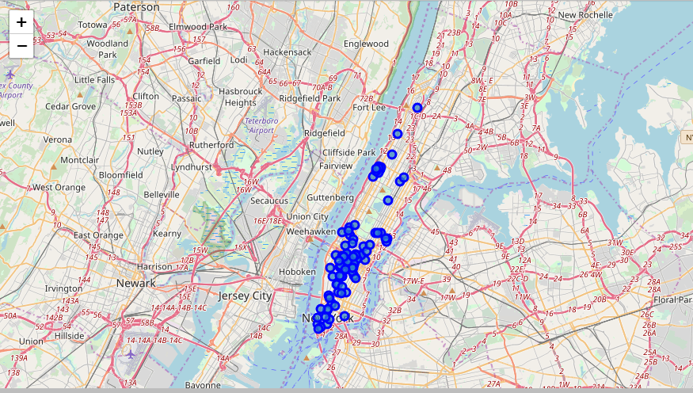
Visualizing the universities and academies of NYC

Slide 5
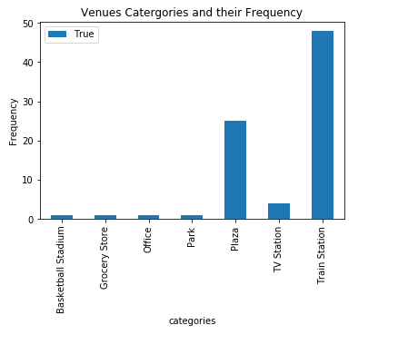
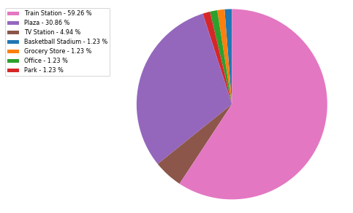
The type of categories of the venues around the universities and their frequencies

Slide 6
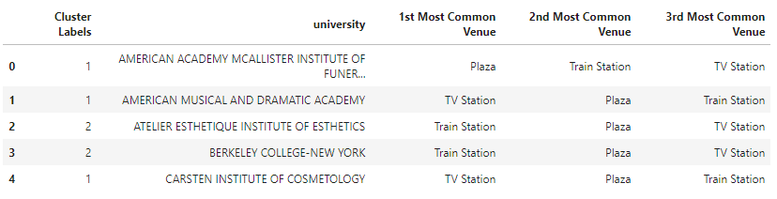
Clustering Model
Clustering the universities based on the common characteristics of trending venues around them

Slide 7
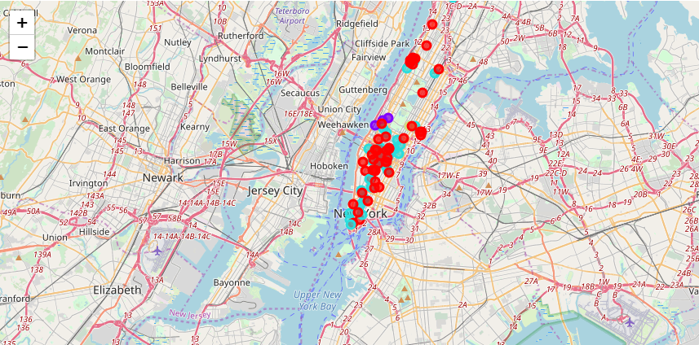
Clustering Model
Clustering the universities based on the common characteristics of trending venues around them

Slide 8
Results
To solve this problem and take a good view of the top venues around the universities in New York City I collected data from the Homeland Infrastructure Foundation-Level Data (HIFLD) website about the universities in New York City and data from the Foursquare website about the trending venues around each university and I found that:
There are 7 distinct categories of the trending venues: train station, plazas, TV station, park, office, grocery store, basketball stadium.
The most frequent venues around the universities are the train stations then the plazas
The least frequent trending venues around the universities are office, grocery store, basketball stadium
Using the provided result and observations the business owner can decide what she/he opens near to the university and provide and how find opportunities there and help then in making the right decision.

